Slide 1
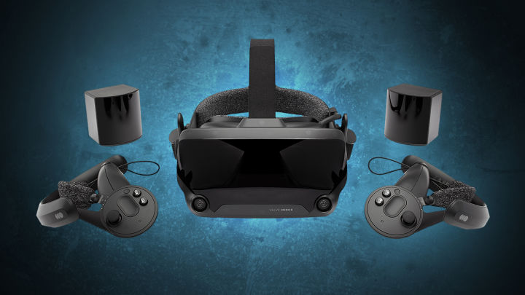
METAVERSE
THE INCOMING TECHNOLOGY & VISUAL WORLD

Slide 2
WHAT IS THE METAVERSE
The term "metaverse" has its origins in the 1992 science fiction novel by Neal Stephenson Snow Crash as a portmanteau of "meta" and "universe." Various metaverses have been developed for popular use such as virtual world platforms like Second Life

Slide 3
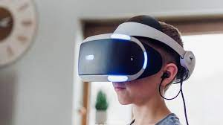
HOW METAVERSE IS WORKS
Metaverse is the next generation of the internet. Blending the elements of virtual reality, augmented reality, online games, social media, and cryptocurrencies; metaverse users in a novel phase of interconnected virtual experience, that reimagines the future of work

Slide 4
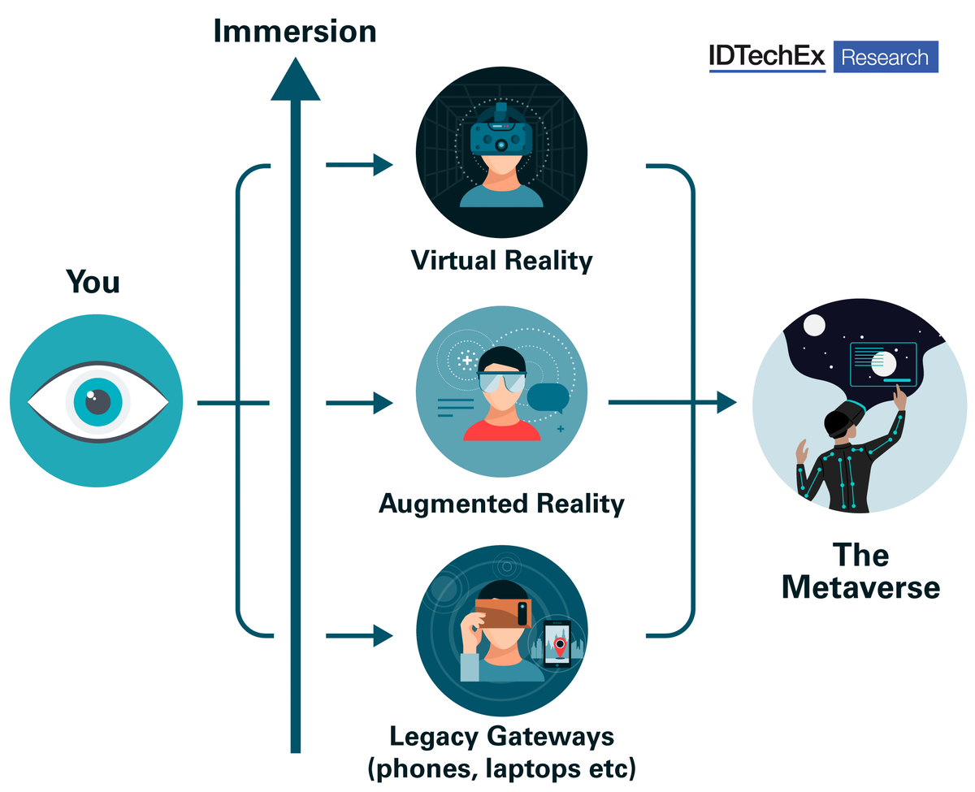

Slide 5
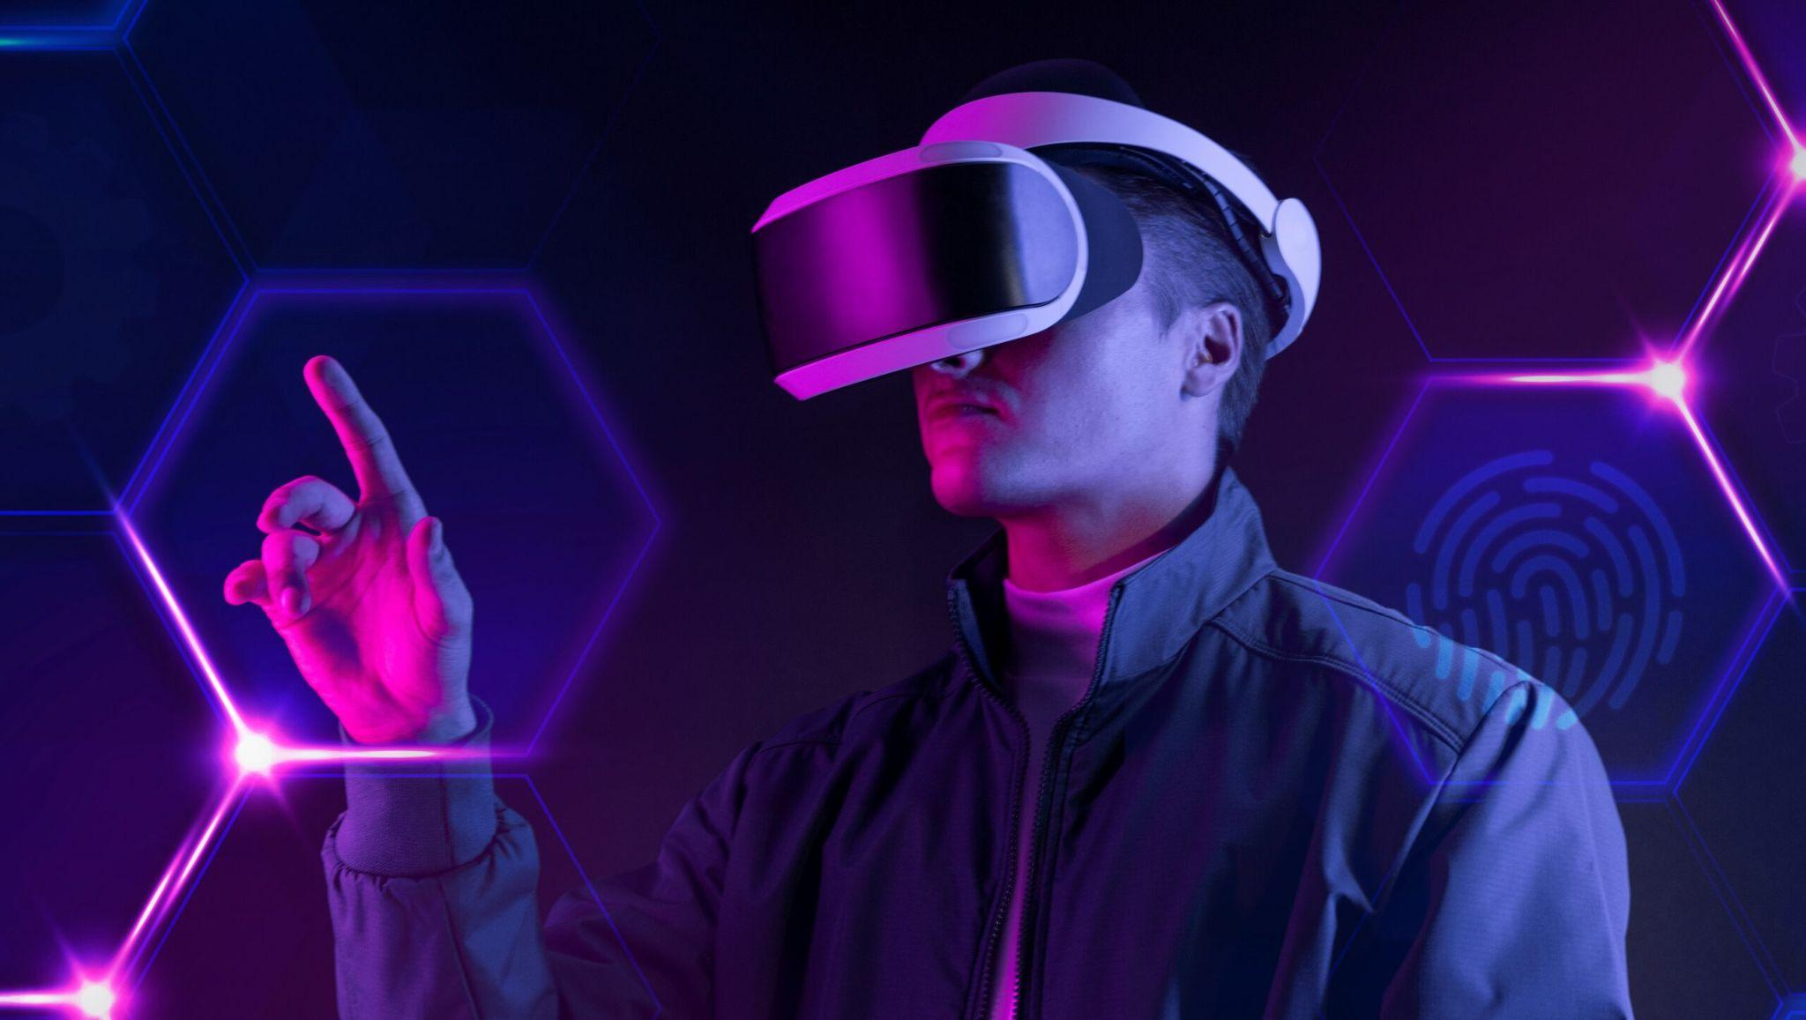
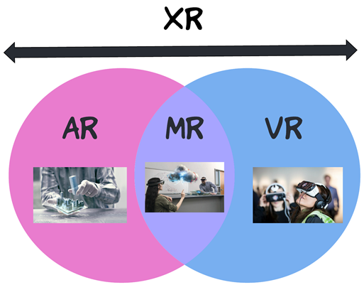
mixed reality"(MR) and "extended reality" (XR) have entered the lexicon. The metaverse will be accessed through technologies such as VR and AR.

Slide 6
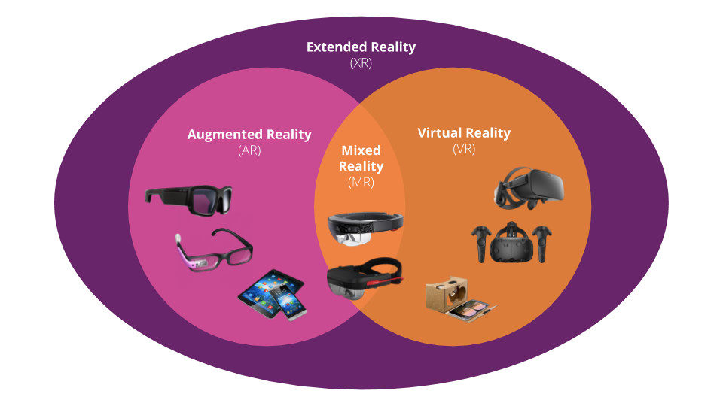

Slide 7
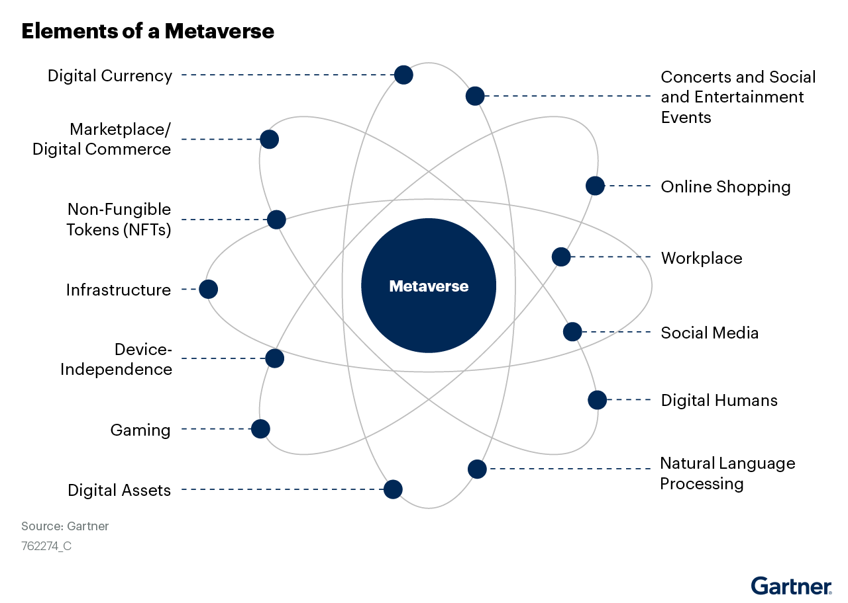
The Area of uses
Gaming.
Social Interaction.
Media and Entertainment.
Virtual Tourism.
Commerce.
Wrap-Up.

Slide 8
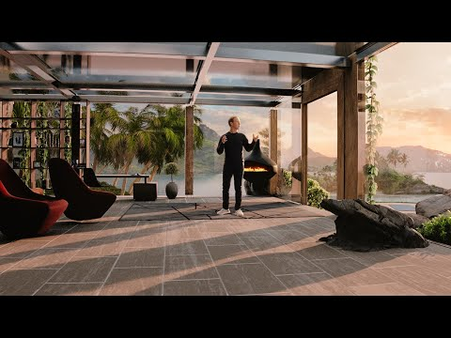
CONNECTING TO THE PEOPLE

Slide 9
GAMING EXPERIENCE IN METAVERSE

Slide 10
WORKING WITH METAVERSE

Slide 11
SPACE EXPERIENCE

Slide 12
THANK YOU
~BY SHUBHAM KHATWASE

